Slide 1
Photomicrographs of Plant foods
Beet
Permission to reproduce original photomicrographs used to make this collection may be obtained from
Dr. David O. Norris at
david.norris@colorado.edu

Slide 2
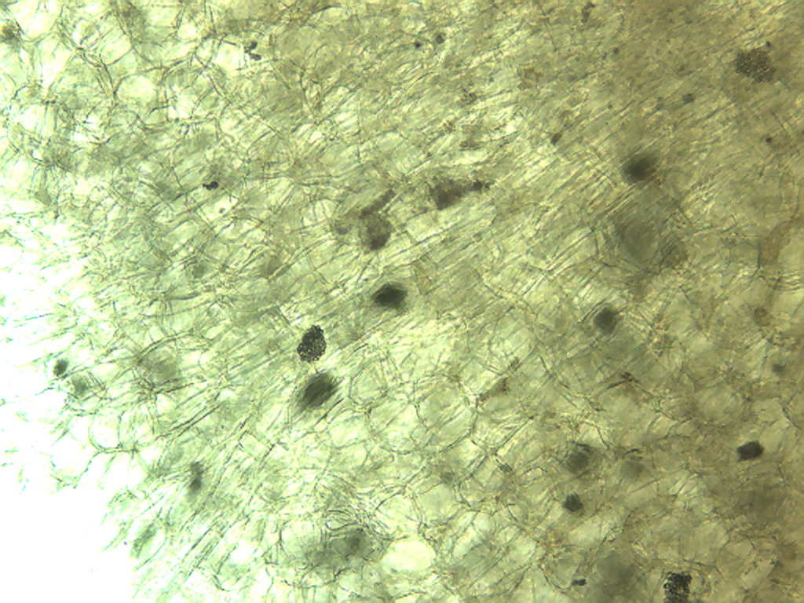
Notes:
76. Beta vulgaris L. Beet. Cuboidal cells with crystals, 10X

Slide 3
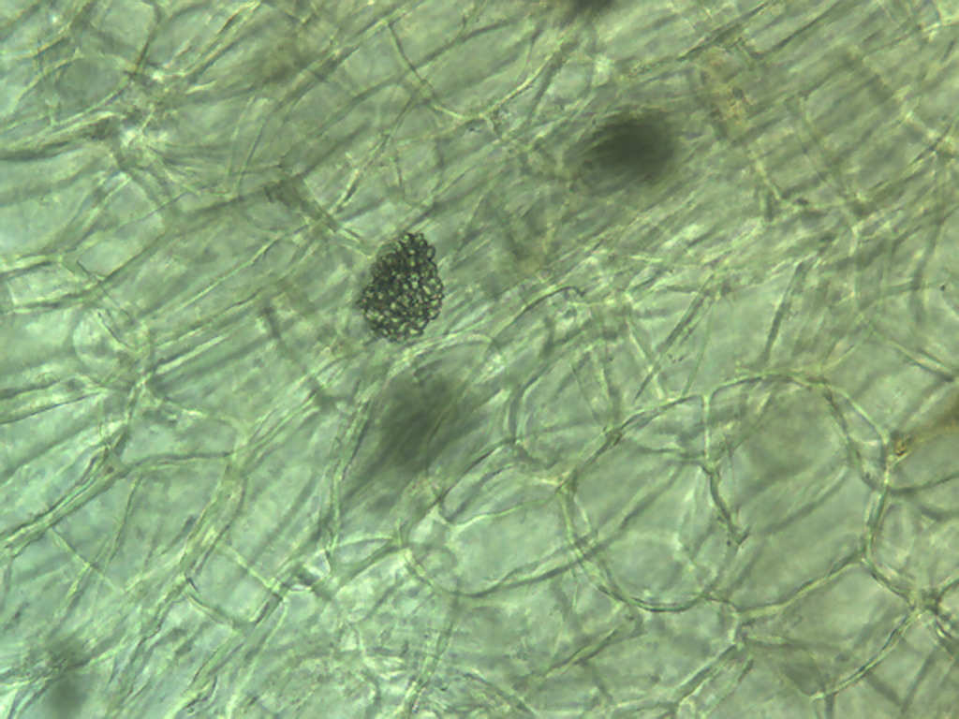
Notes:
77. Beet. Cuboidal cells with crystals, 25X

Slide 4
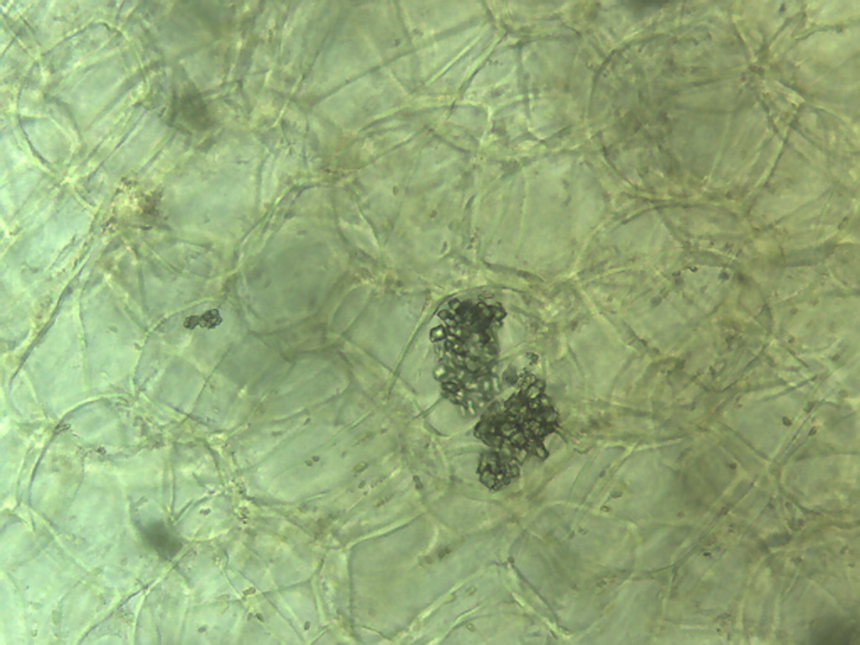
Notes:
78. Beet. Cuboidal cells with crystals, 25X

Slide 5
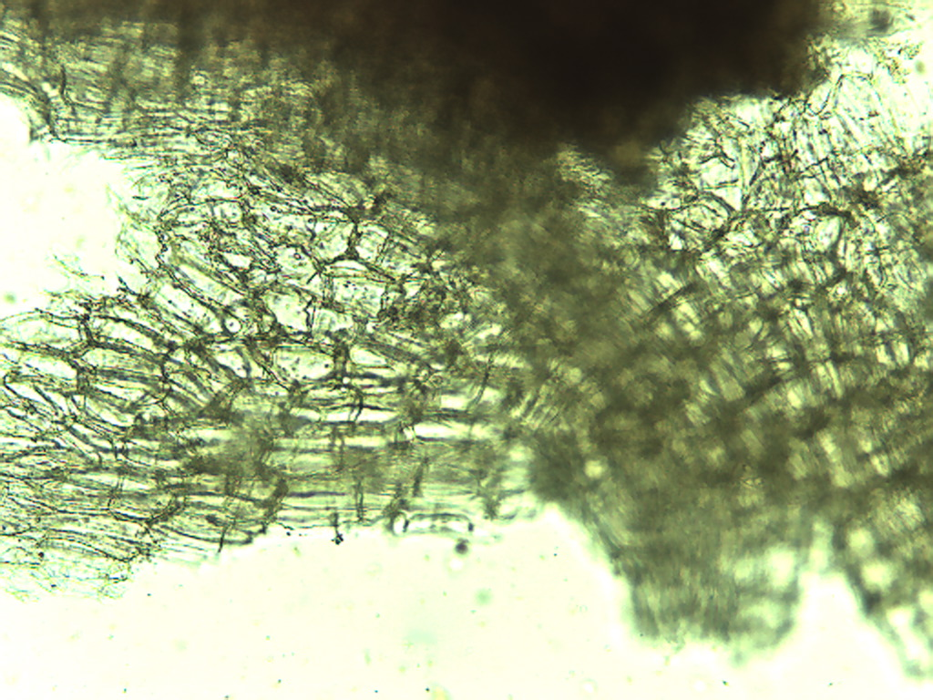
Notes:
79. Beet. Surface epidermal cells, 10X.

Slide 6
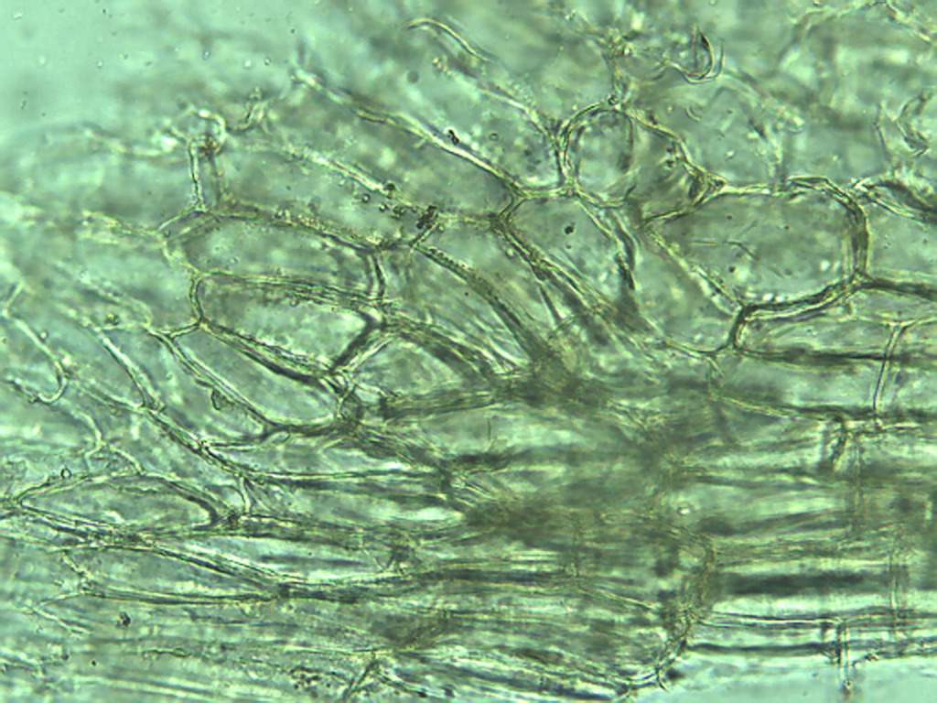
Notes:
80. Beet. Surface epidermal cells, 25X.

Slide 7
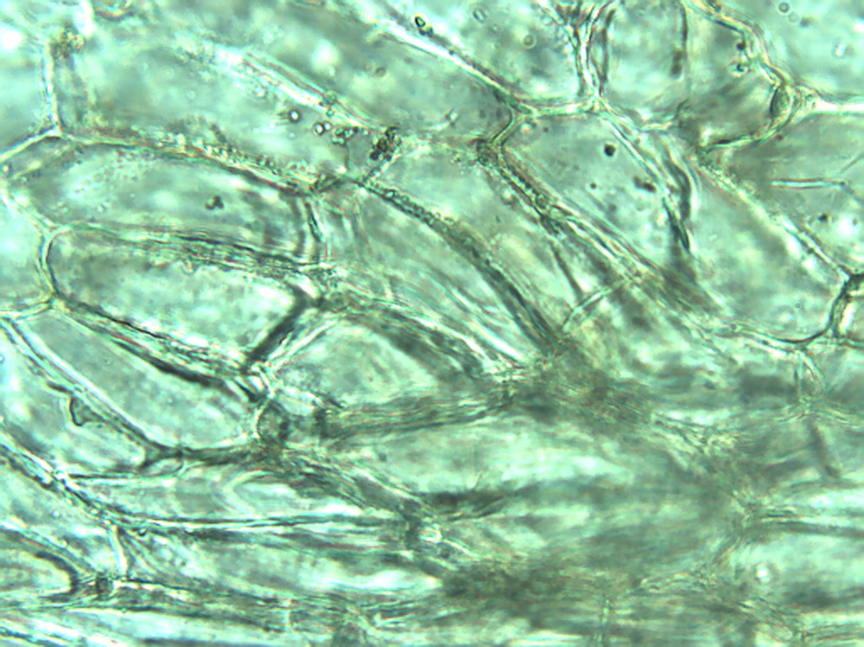
Notes:
81. Beet. Surface epidermal cells, 40X.

Slide 8
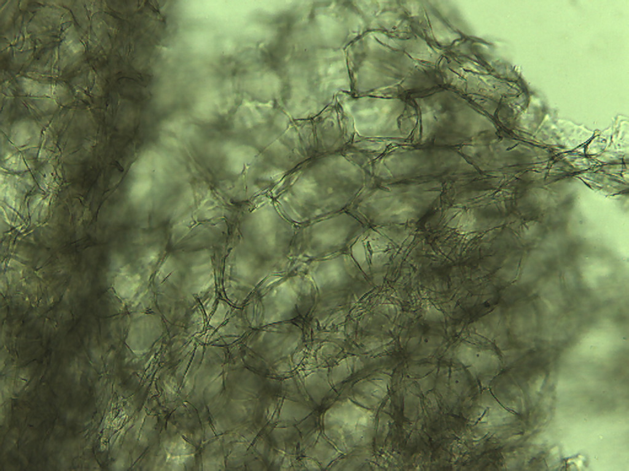
Notes:
82. Beet. Parenchymal cells, 10X.

Slide 9
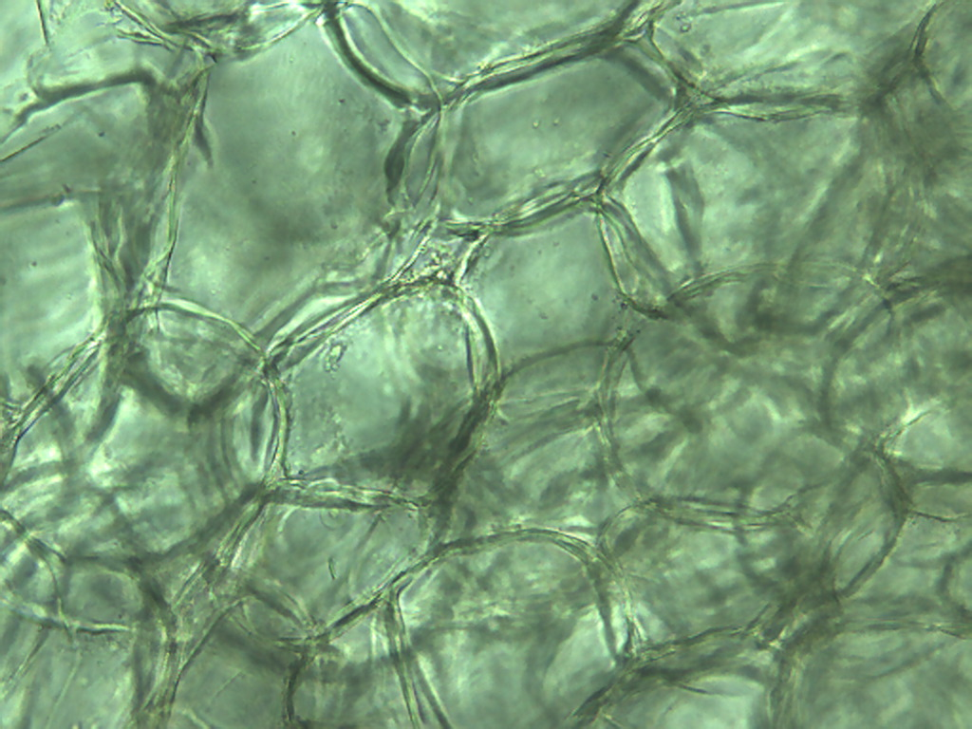
Notes:
83. Beet. Parenchymal cells, 25X.

Slide 10
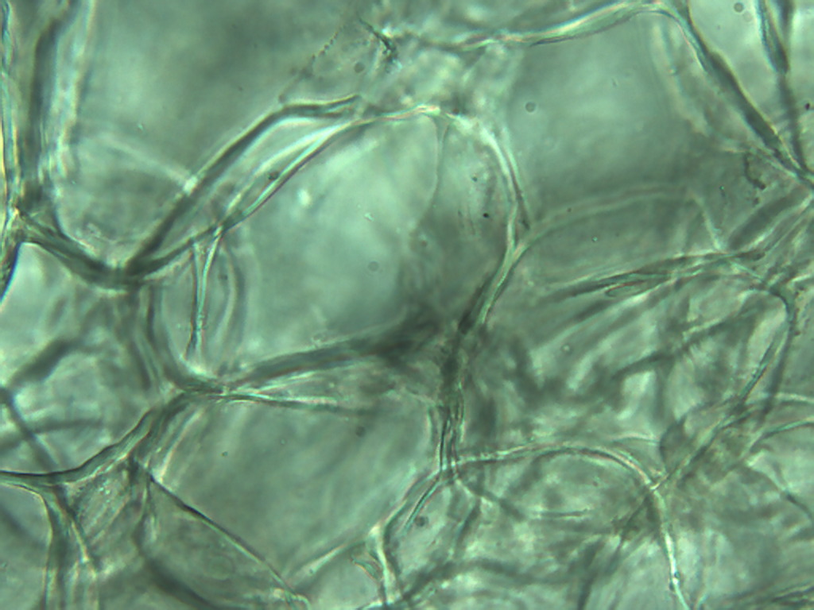
Notes:
84. Beet. Parenchymal cells, 40X.

Slide 11
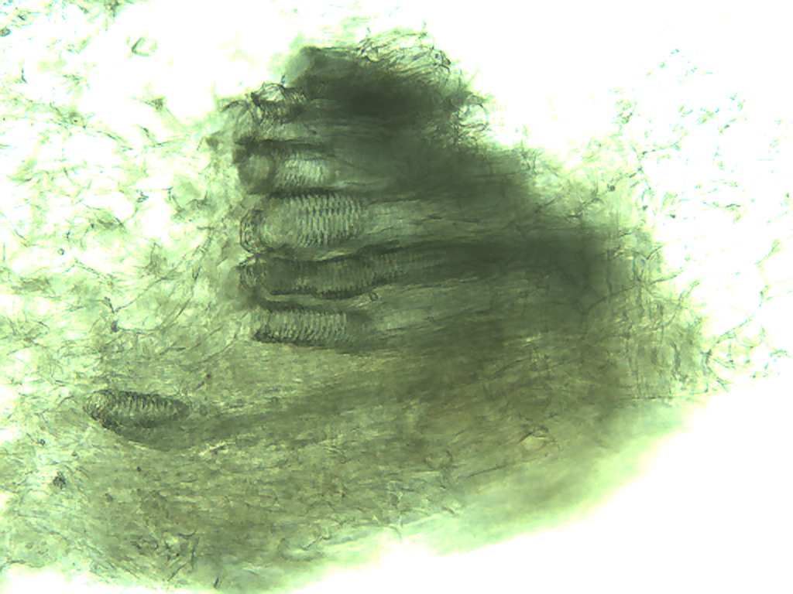
Notes:
85. Beet, Vascular tissue, 10X.

Slide 12
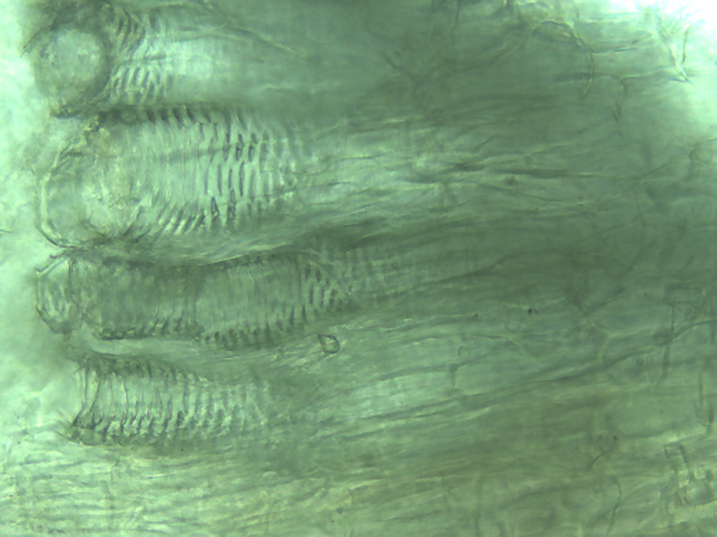
Notes:
86. Beet. Vascular tissue, 25X.

Slide 13
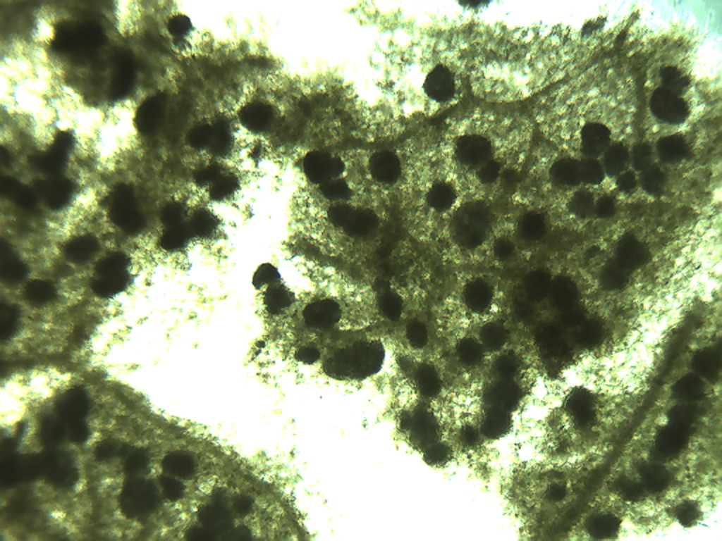
Notes:
87. Beet. Leaf surface, 4X. Pigment-laden cell (arrow).

Slide 14
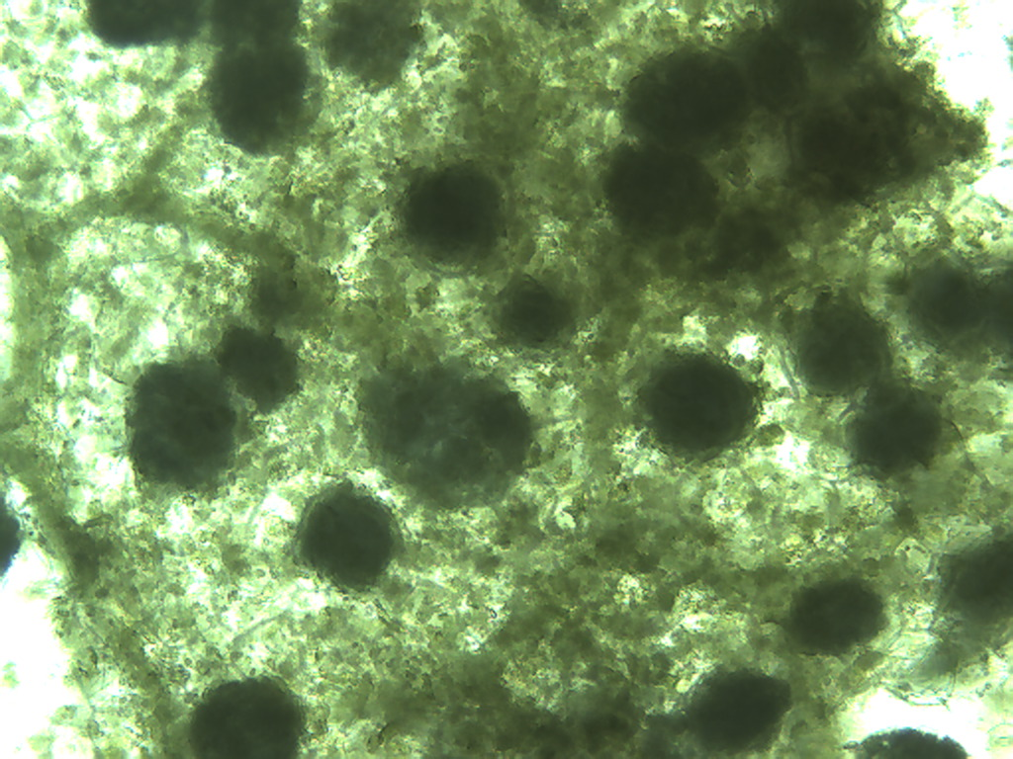
Notes:
88. Beet. Leaf, 25X.

Slide 15
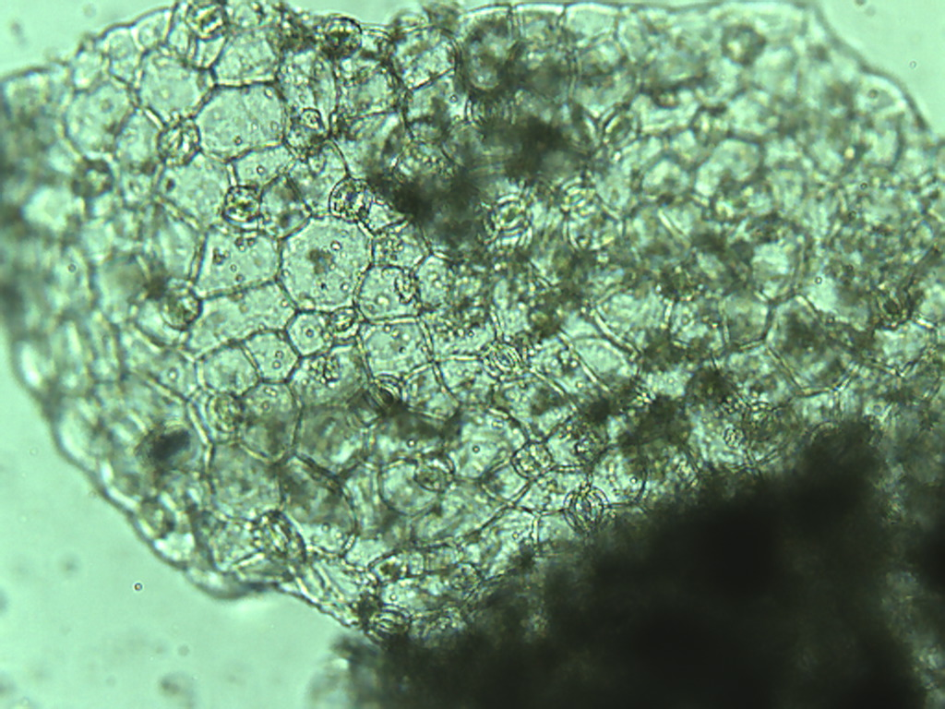
Notes:
89. Beet. Leaf epidermis, 10X.

Slide 16
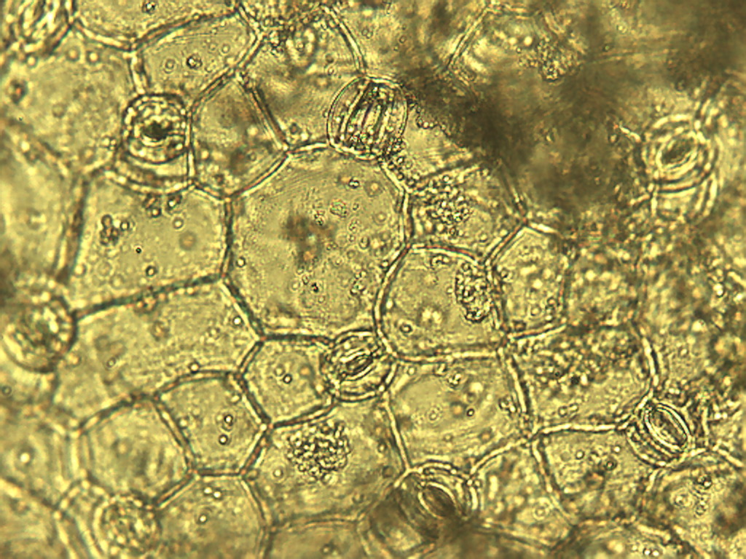
Notes:
90. Beet. Leaf epidermis, no filter, 25X.

Slide 17
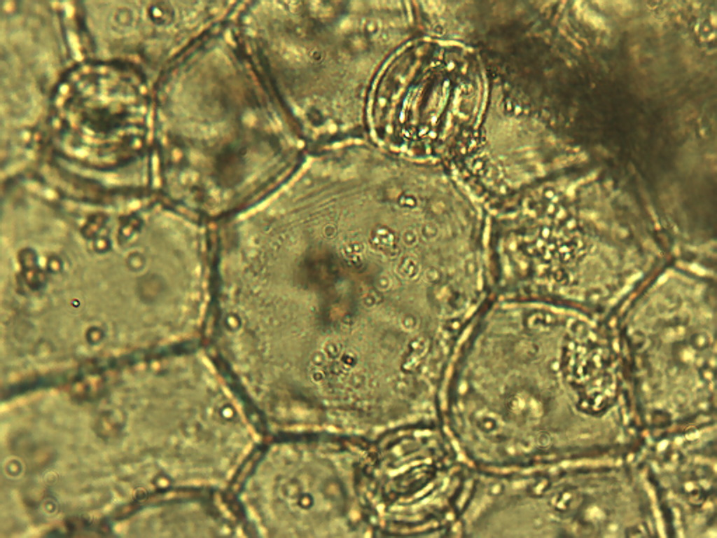
Notes:
91. Beet. Leaf epidermis with stomates (arrows), no filter, 40X.

